Slide 1


Slide 2
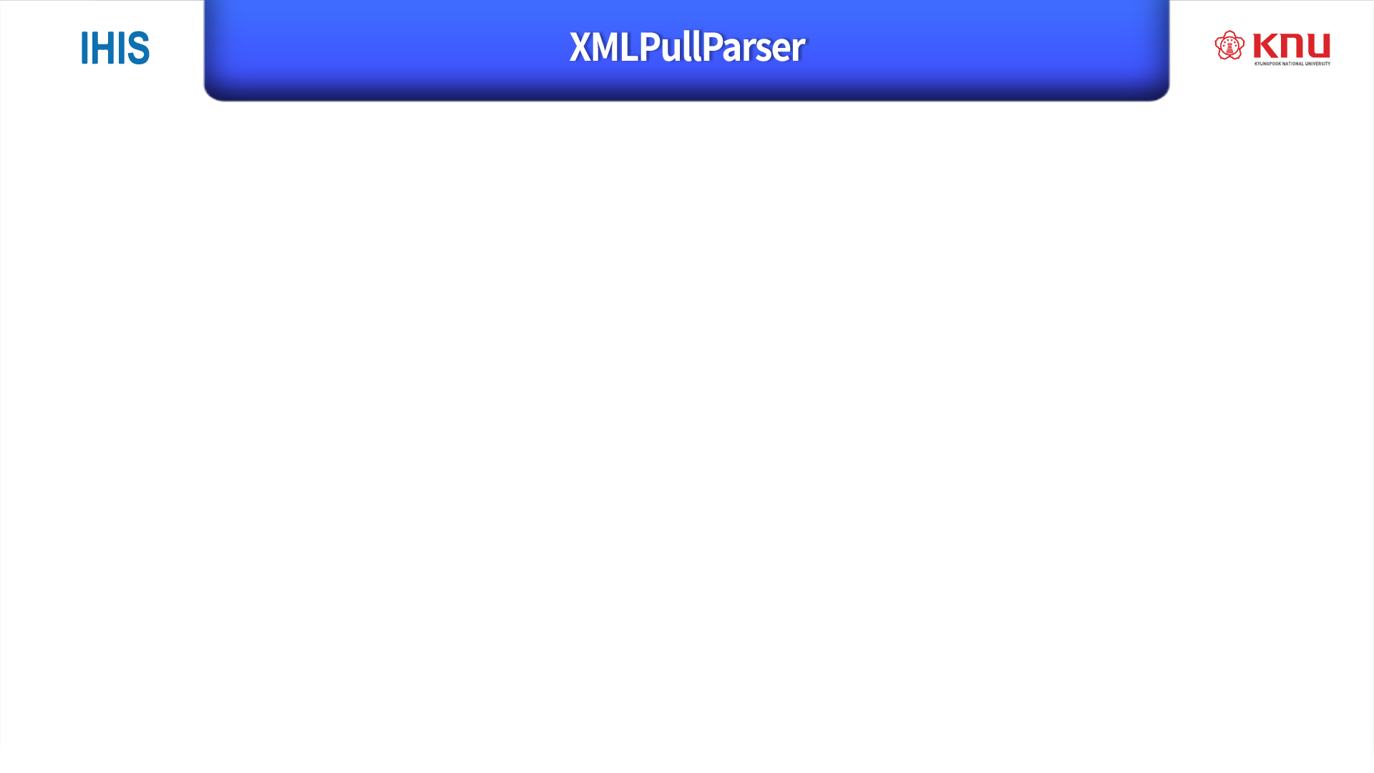
Kind of XML Parser
Easy to use

Slide 3
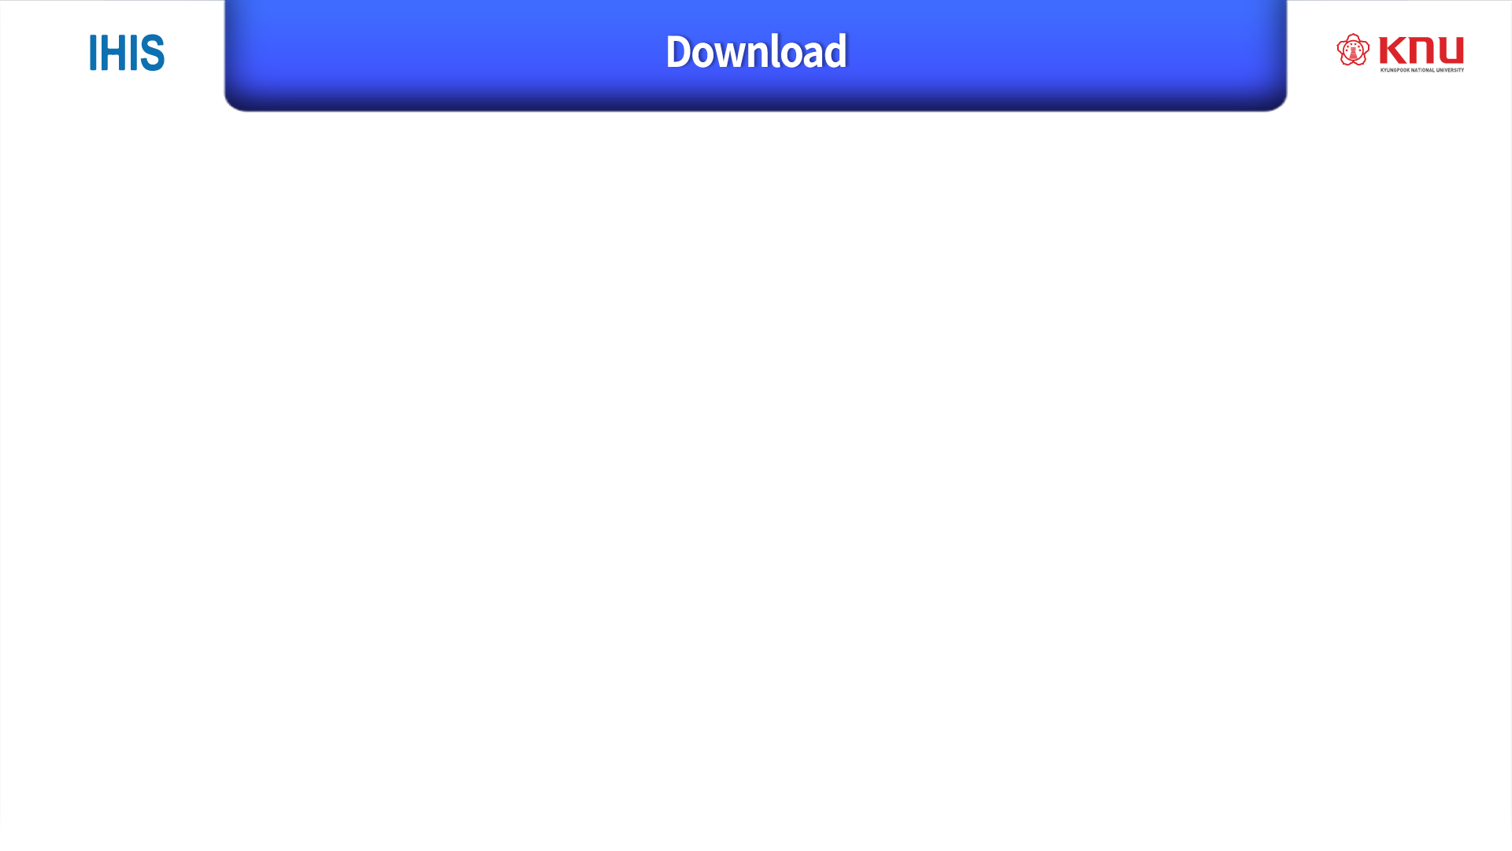
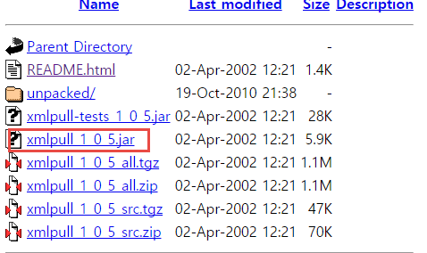
XMLPullParser Jar File - http://www.xmlpull.org/v1/download/
KXML File(support XMLPullParser) - http://kxml.org/

Slide 4
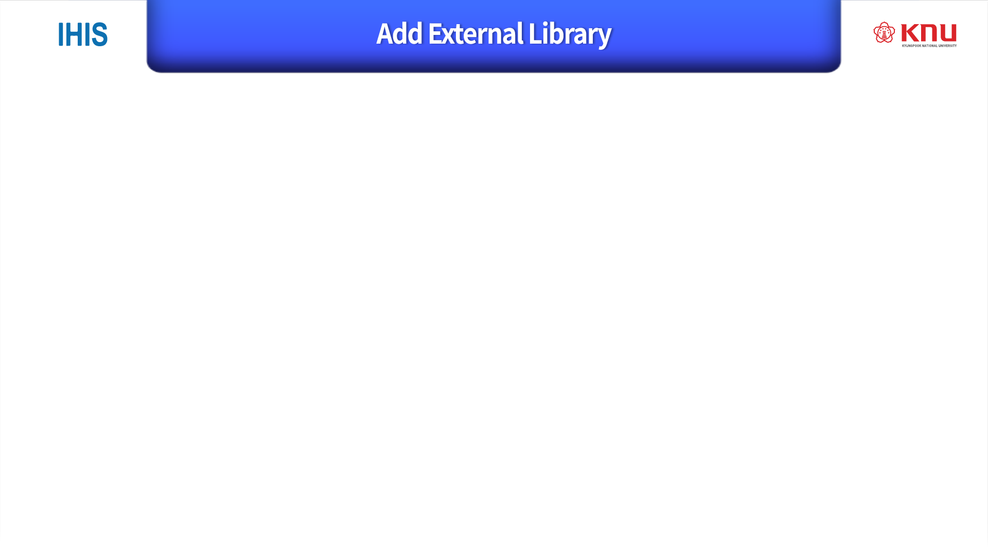
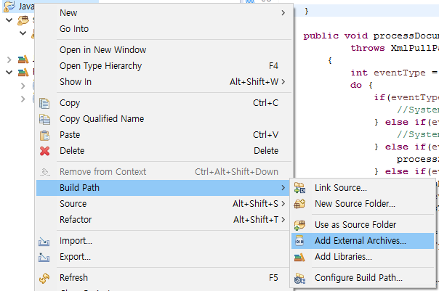
Select jar file

Slide 5
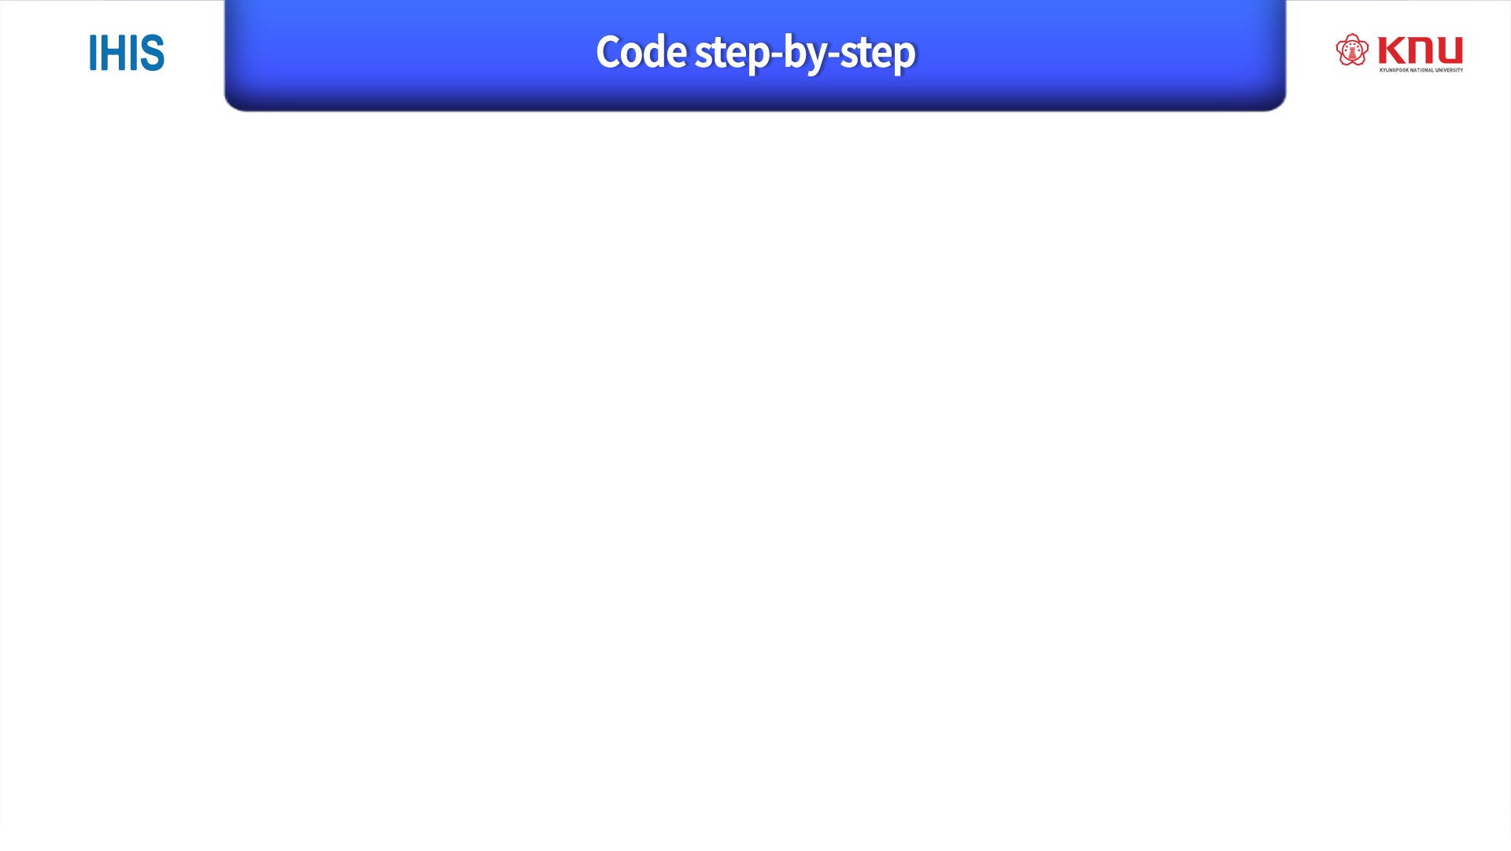
get instance of XMLPULL facotry
(optional step) by default factory will produce parsers that are not namespace aware; to change setNamespaceAware() function must be called
create an instance of the parser
Code
XmlPullParserFactory factory = XmlPullParserFactory.newInstance(); factory.setNamespaceAware(true);
XmlPullParser xpp = factory.newPullParser();

Slide 6
4. Next step is to set parser input:
xpp.setInput ( new FileReader ( args [i] ) );
5. Typical XMLPULL applicaition will repeatedly call next()
function to retrieve next event, process event until the event is
END_DOCUMENT:
public void processDocument(XmlPullParser xpp) throws XmlPullParserException, IOException {
int eventType = xpp.getType();
do {
if(eventType == xpp.START_DOCUMENT) {
System.out.println("Start document");
} else if(eventType == xpp.END_DOCUMENT){
System.out.println("End document");
} else if(eventType == xpp.START_TAG) {
processStartElement(xpp);
} else if(eventType == xpp.END_TAG) {
processEndElement(xpp);
} else if(eventType == xpp.TEXT) {
processText(xpp);
} eventType = xpp.next();
}
while (eventType != xpp.END_DOCUMENT);
}

Slide 7

START DOCUMENT
document start - parser has not yet read any input
START_TAG
parser is on start tag
TEXT
parser is on element content
END_TAG
parser is on end tag
END_DOCUMENT
document finished and no more parsing is allowed

Slide 8
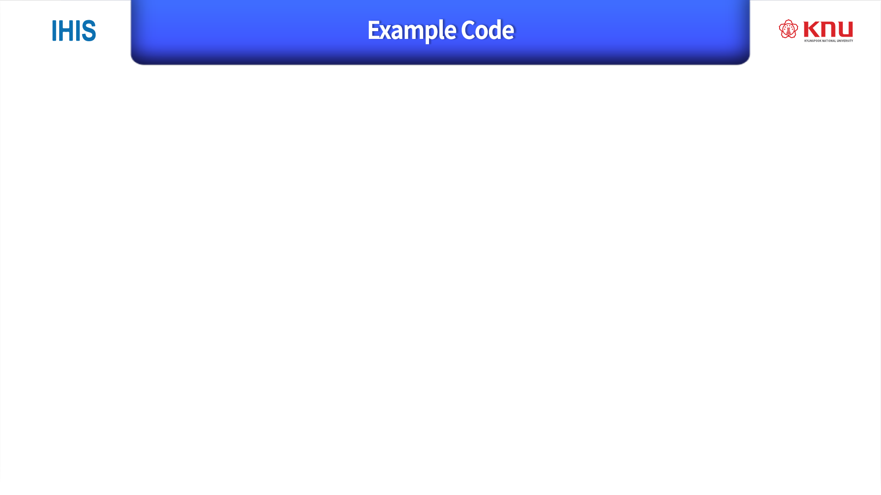
import java.io.BufferedReader;
import java.io.IOException;
import java.io.InputStream;
import java.io.InputStreamReader;
import java.net.HttpURLConnection;
import java.net.MalformedURLException;
import java.net.URL;
import org.xmlpull.v1.XmlPullParser;
import org.xmlpull.v1.XmlPullParserException;
import org.xmlpull.v1.XmlPullParserFactory;
public class JavaHttpConnection {
public static void main(String[] args) {
String urlStr = "https://openapi.naver.com/v1/search/blog.xml?query=%EB%A6%AC%EB%B7%B0&display=10&start=1&sort=sim";
String naverAPI_ID = ;
String naverAPI_PW = ;
URL url = null;
HttpURLConnection connection = null;
try {
url = new URL(urlStr);
} catch (MalformedURLException e) {
e.printStackTrace();
}
try {
connection = (HttpURLConnection)url.openConnection();
} catch (IOException e) {
e.printStackTrace();
}
connection.setRequestProperty("Content-Type", "application/xml"); // 받을요청타입
connection.setRequestProperty("X-Naver-Client-Id", naverAPI_ID); //발급받은 ID
connection.setRequestProperty("X-Naver-Client-Secret", naverAPI_PW); //발급받은 PW
BufferedReader rd = null;
try {
rd = new BufferedReader(
new InputStreamReader(connection.getInputStream()));
} catch (IOException e) {
e.printStackTrace();
}
try {
XmlPullParserFactory factory = XmlPullParserFactory.newInstance();//XMLPullParser를 이용하여 파싱
factory.setNamespaceAware(true);
XmlPullParser xpp = factory.newPullParser();
xpp.setInput(rd);//파싱할 데이터 입력
JavaHttpConnection myConnection = new JavaHttpConnection();//함수 사용을 위해 클래스 생성
myConnection.processDocument(xpp);//파싱 함수
} catch (XmlPullParserException e1) {
e1.printStackTrace();
} catch (IOException e) {
e.printStackTrace();
}
}
public void processDocument(XmlPullParser xpp)
throws XmlPullParserException, IOException
{
int eventType = xpp.getEventType();
do {
if(eventType == xpp.START_DOCUMENT) {
//System.out.println("Start document");
} else if(eventType == xpp.END_DOCUMENT) {
//System.out.println("End document");
} else if(eventType == xpp.START_TAG) {
processStartElement(xpp);
} else if(eventType == xpp.END_TAG) {
processEndElement(xpp);
} else if(eventType == xpp.TEXT) {
processText(xpp);
}
eventType = xpp.next();
} while (eventType != xpp.END_DOCUMENT);
}
public void processStartElement (XmlPullParser xpp)
{
String name = xpp.getName();
String uri = xpp.getNamespace();
if ("".equals (uri)) {
System.out.println("<" + name + ">");
} else {
System.out.println("<"+ uri +":" + name + ">");
}
}
public void processEndElement (XmlPullParser xpp)
{
String name = xpp.getName();
String uri = xpp.getNamespace();
if ("".equals (uri))
System.out.println("</" + name + ">");
else
System.out.println("</"+ uri +":" + name + ">");
}
int holderForStartAndLength[] = new int[2];
public void processText (XmlPullParser xpp) throws XmlPullParserException
{
char ch[] = xpp.getTextCharacters(holderForStartAndLength);
int start = holderForStartAndLength[0];
int length = holderForStartAndLength[1];
System.out.printf("Content:");
for (int i = start; i < start + length; i++) {
switch (ch[i]) {
case '\\':
System.out.print("\\\\");
break;
case '"':
System.out.print("\\\"");
break;
case '\n':
System.out.print("\\n");
break;
case '\r':
System.out.print("\\r");
break;
case '\t':
System.out.print("\\t");
break;
default:
System.out.print(ch[i]);
break;
}
}
System.out.print("\n");
}
}

Slide 9

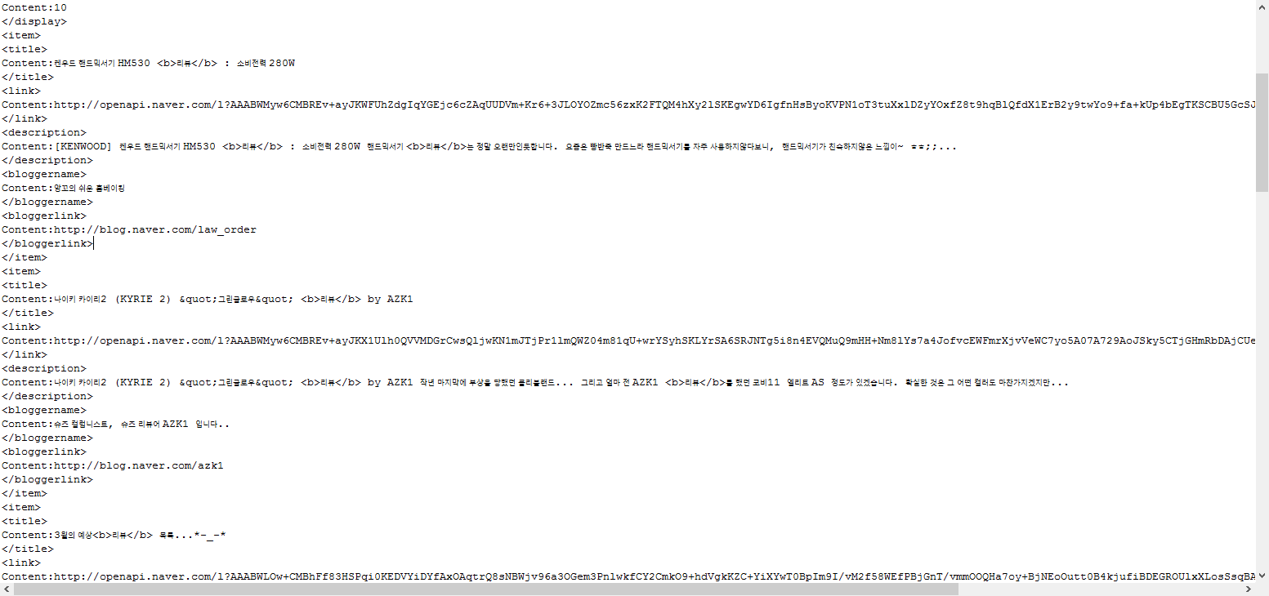

Slide 10


